Slide 1

. FPGA-based Quantized Simulated Bifurcation Machine
Hong Kong University of Science and Technology (HKUST)

Slide 2
Outline
Background
Motivation
Quantized Simulated Bifurcation
SpMV
Hardware Architecture
Workflow
Result
Future Improvement

Slide 3
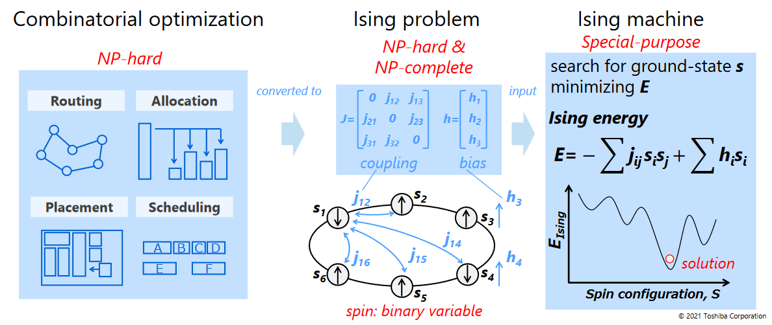
Background: Combinatorial Optimization
1. Combinatorial Optimization & Ising
Combinatorial Optimization usually can be express by finding a set of variable (s1, s2, …) that minimize cost function C (s1, s2, …)
Mapping a combinatorial problem to Ising model providing a more intuitional way to solve it.

Slide 4
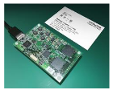
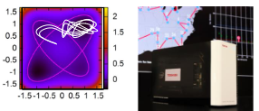

Background: Ising Machine
Ising Machine
The Ising Machine is developed based on two principles, annealing and bifurcation
Annealing
Bifurcation
Simulated Bifurcation Machine (SBM)
CMOS
Annealing
Coherent Ising Machine (CIM)
HITACHI
2015-
Toshiba 2019-
NTT/Stanford/U-Tokyo
2016-
Notes:
As the Simulated Bifurcation is more hardware friendly,

Slide 5
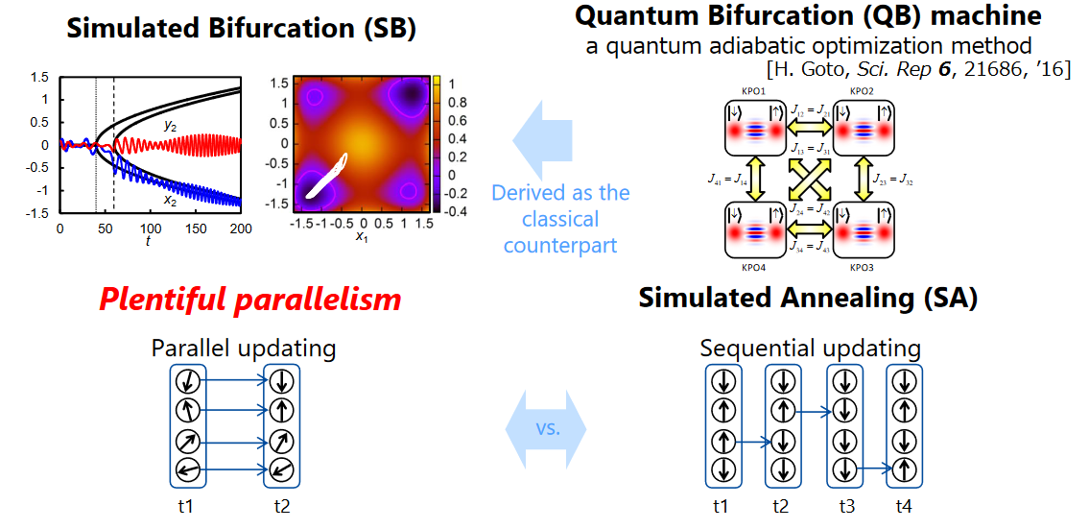
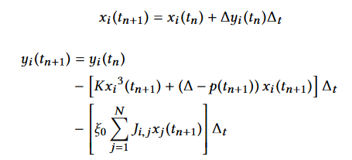

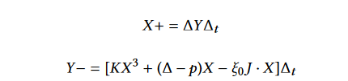
Background: Simulated Bifurcation
Update principle
By applying Hamilton dynamic, Multiple ising spin can update their position / momentum at the same time. As the detailed formula (1) shown right below. Which is much faster compared with annealing
2. Matrix Multiplication (MM) and Time Evolution (TE)
By simplification (2), SB can be divided into MM
(1)
J * X
And TE
(2)
Notes:
1. By updating multiple times, the energy of the system will converge to lowest state. Which means a solution to Ising model. However there is no guarantee to the solution.
2. J*X stands for Many-body interaction physically speaking, Which is more understandable as momentum exchange, and TE is linear approximation of next position of the particle / Ising spin.

Slide 6
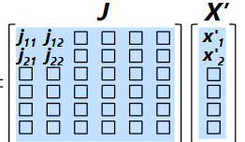
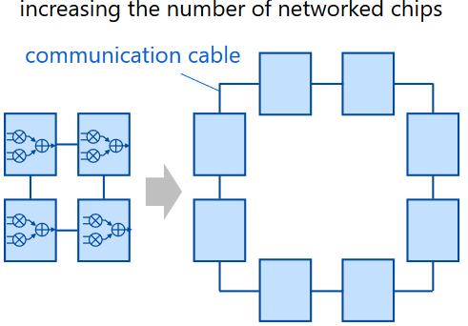
Motivation
SB has large resource overhead
As problem size surge with O(n), the connection matrix J go up with O(n^2), usually way more than capacity of BRAM,
Therefore, we need to solve resource problem
Quantized Ising
Graph
In GB level
2. Storing connection matrix
First, The connection matrix can be stored in off chip DDR to avoid storage overhead. Besides, we use quantization to lower computation overhead further.
Off chip DDR
FPGA board
3. Compared to Toshiba
Toshiba’s design divide large connection matrix into multiple area and let multiple FPGAs handle them

Slide 7
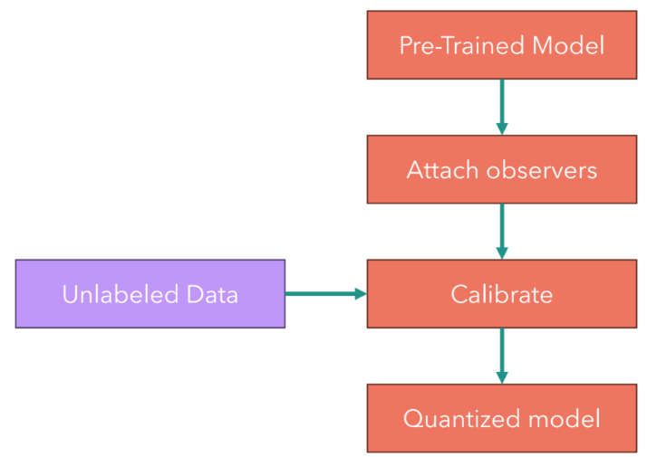

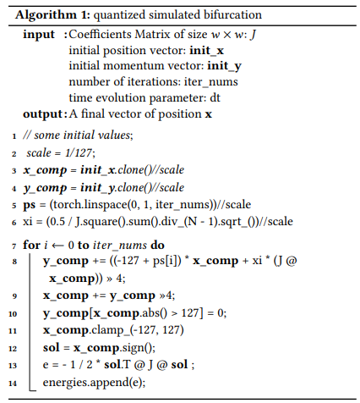
Quantized Simulated Bifurcation
1. Post Training Quantization (PTQ)
The PTQ map a large range of float/real number (r) into a small range of integer number (q)
And calibrate scaling factor S to improve result.
2. Map Simulated Bifurcation to Quantization Model
Floating
point
Connection matrix
Floating
point
x/p vector
Connection matrix
x/p vector
4 bit
8 bit
Notes:
1.
2. As Simulated Bifurcation works resemble neural network, with the both core part is matrix multiplication, and iteration multiple times. The connection matrix J and momentum position pair X can be easily map to quantization model. By quantization, we not only set new precision for J and X, but also set a new rules for SB, as the formula shown on the left.

Slide 8
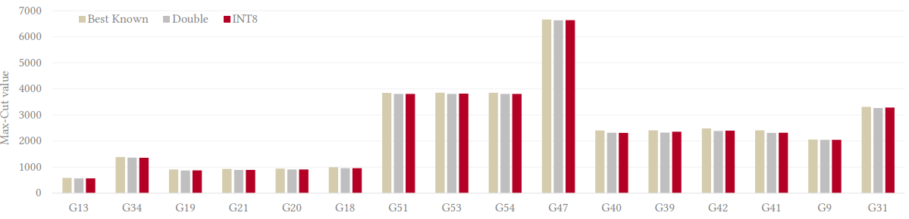
Quantized Simulated Bifurcation (cont.)
1. Quantized result
Average Max-Cut value compared to double precision result
Notes:
In order to evaluate the correctness of QSB, a practical Ising problem, Max-Cut (See Supplementary 1), is applied. we drive some Max-Cut problem value and comparing with value calculated by double precison dSB, the result guaranteeing the feasibility of the quantized SB.

Slide 9
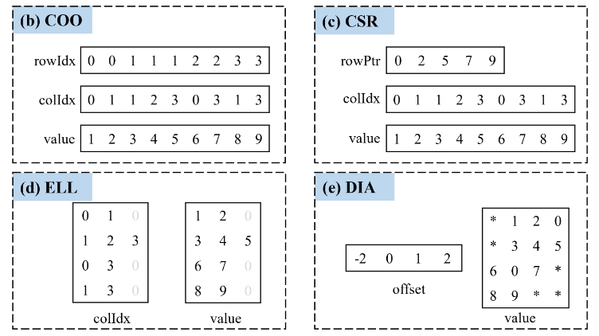
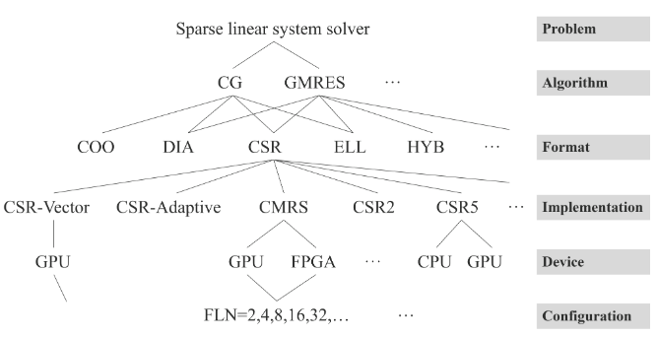
SpMV: Background
Previous SpMV works
The majority of spmv optimization are based on CSR (or improved format) and implemented on GPU/FPGA
2. Touchstone
GPU library CuSparse targeting at SpMV is selected as the benchmark to compared efficiency of our work.
Notes:
1. We choose COO as SpMV base format. COO stands out for its conciseness and extendibility. COO can easily adapt to RAM and stream transmission compared to other irregular formats. And COO storing efficiency is not necessarily bad.
2. As there are many works based on GPU, we found a frequently used high performance SpMV GPU lib CuSparse as benchmark. Which is also official lib of CUDA

Slide 10
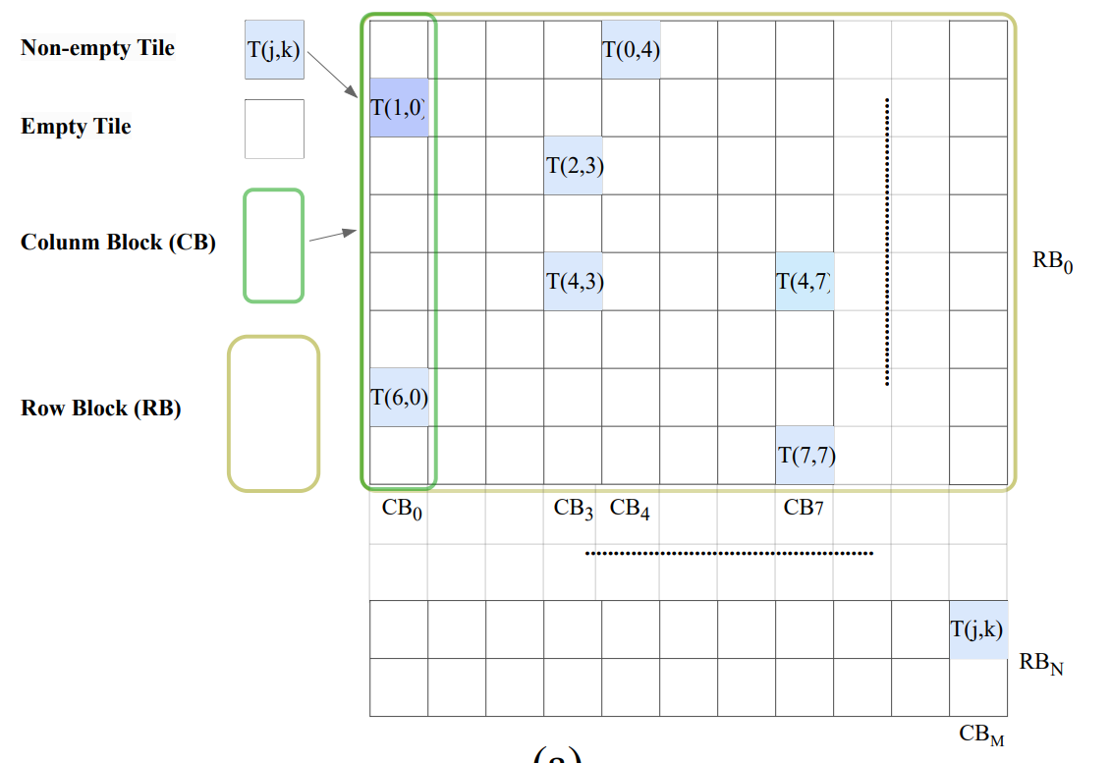
SpMV: Method
TCOO
In our design, we improved COO and And respective control and data flows have been improved to fully exploit off-chip memory bandwidth, empowering multiple Process Elements (PEs) with auto workload balance.
PE
PE
Let different PEs handle different Tiles
Notes:
The main idea of TCOO is to split matrix into sub-matrix (which is called Tile), and let multiple PE handle them separately. In our design, we identify eight contiguous Tiles in the same column range forming a matrix of size 512 ∗ 64 as a Column Block (CB). Each CB will be sent to a PE. All of the CBs in the same row direction form a Row Block (RB). As the matrix size is very large, all PE will be processing a same RB at the same time.
By doing so we can extend the multiprocessing ability of FPGA and auto workload balance which we will show later.

Slide 11
SpMV: Method (cont.)
1. TCOO: Ping Pong Operation
TE
GE
RB0
PE
PE
RB1
x
=
MM
RB2
RB3
Notes:
Will PE is performing MM for second RB, the MM result of first RB is used by GE to perform TE.

Slide 12
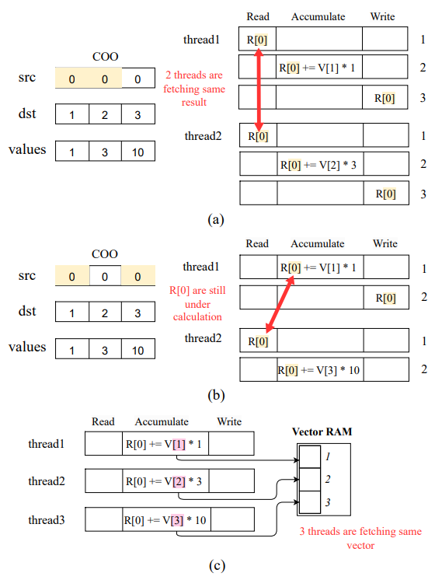
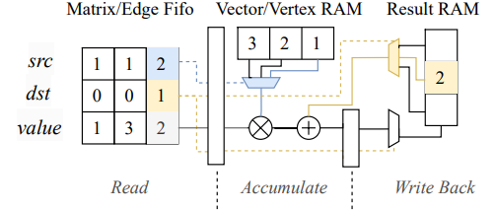
SpMV: Hazard
Hazard
SpMV has some intrinsic hazard caused by either storage format like COO and hardware structure. (a) Intra-stage hazard happened at same pipeline stage of different threads; (b) Interstage hazard happened at contiguous pipeline stages of different threads; (c) Structural hazard happened when multiple threads trying to fetch same vector
Notes:
On the left is a single thread SpMV hardware structure example based on COO, however if we extend single thread to multiple thread, we will encounter several hazard listed on the right.
Data Hazard: A data hazard occurs when multiple threads read, accumulate, and write the same vector value. This includes both the intra-stage hazard and the inter-stage Read-After-Write (RAW) Hazard. An intra-stage hazard occurs when different thread read and update the same 𝑅𝑒𝑠𝑢𝑙𝑡 vector at the same pipeline stage. An inter-stage RAW hazard occurs when the updated value has been read out at the next pipeline stage before the calculation result from the previous pipeline stage is written back. Fig. 14 shows two hazards. For the intra-stage hazard, two threads read 𝑅[0] in stage 1 and perform calculations separately, whereas the two values should be added together. For the RAW hazard, thread2 fetches 𝑅[0] while thread1 is still accumulating the 𝑅[0], resulting in thread1 reading an incorrect value.
Structural Hazard: A structural hazard can be defined as a hazard caused by multiple threads attempting to write to the same Result RAM. Considering that when there are multiple threads, each thread can access the SpMV Result RAM for Write Back (see Fig. 14 (c)). However, even the most complex Block RAM (BRAM) in Xilinx FPGA has at most two ports for writing at the same time. Therefore, implementing the SpMV RAM as BRAM limits the parallelism of multiple threads. Upon accessing the BRAM, either the threads stall or the workload is rescheduled

Slide 13
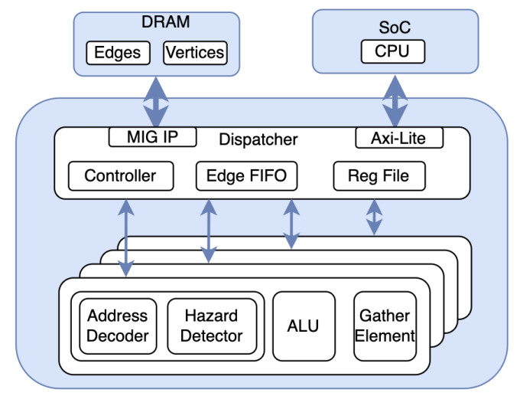
Hardware Architecture
Overall structure
The overall structure contains a dispatcher that moves data from DDR to PE and back. And a PE for Matrix Multiplication, a Gather Elements for Time Evolution,
Notes:
1. The PE and GE works in Ping Pong manner to achieve TCOO ping pong mode mentioned before

Slide 14
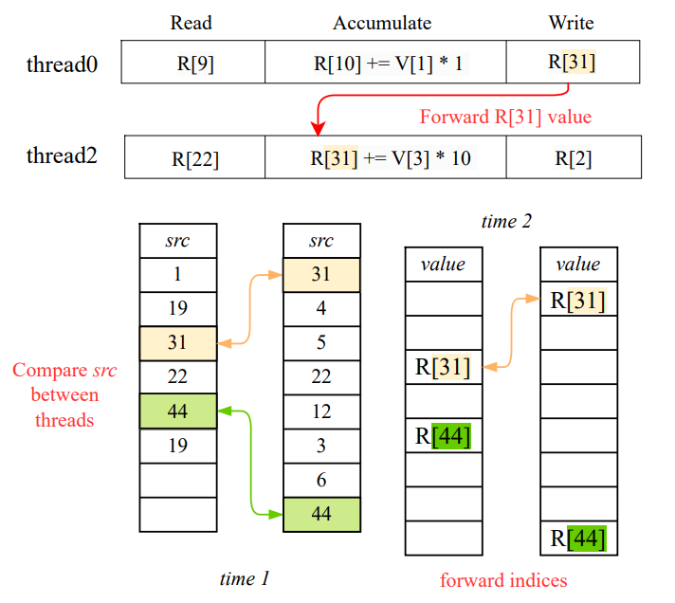
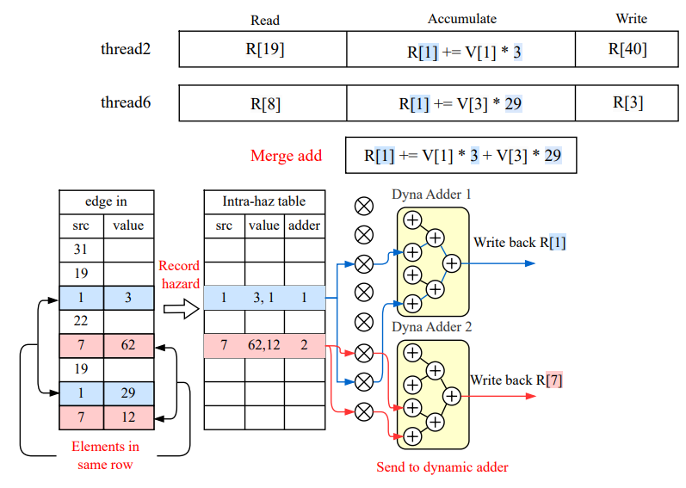
Hardware Architecture (cont.)
RAW hazard
RAW hazard is overcome by forward latest Result value to other thread
2. Intra-stage hazard
If multiple threads process edge of same row, the result will be sent to merge adder
3. structural hazard
BRAM is replaced by register to guarantee access of multiple threads
BRAM
PE
register
PE
register
Notes:
We have applied several strategy to avoid hazard.
Data forwarding allows data from each PE thread to be forwarded to all other threads to prevent RAW hazards. It identifies and records conflicting edge src between threads at the 𝑅𝑒𝑎𝑑 and 𝐴𝑐𝑐𝑢𝑚𝑢𝑙𝑎𝑡𝑒 stages. If a hazard occurs, like between thread0 and thread2 in Fig, the Result is forwarded from the 𝑊 𝑟𝑖𝑡𝑒𝐵𝑎𝑐𝑘 stage of thread0 to the 𝐴𝑐𝑐𝑢𝑚𝑢𝑙𝑎𝑡𝑒 stage of thread2.
Dynamic Adder inputs edges of eight threads with identical 𝑠𝑟𝑐 to the dynamic adder in the 𝐴𝑐𝑐𝑢𝑚𝑢𝑙𝑎𝑡𝑒 stage, sidestepping intrastage hazards.
Replacing the BRAM with register eliminates structure hazard. The atomic operation of register access is guaranteed by hazard elimination mentioned above, making sure that any register will not be read or write at the same time. However, when the register address width increases 𝑂(𝑁), FPGA LUT usage increases by 𝑂(2 𝑁 ). We carefully implement the register address range to avoid any logic overhead.

Slide 15
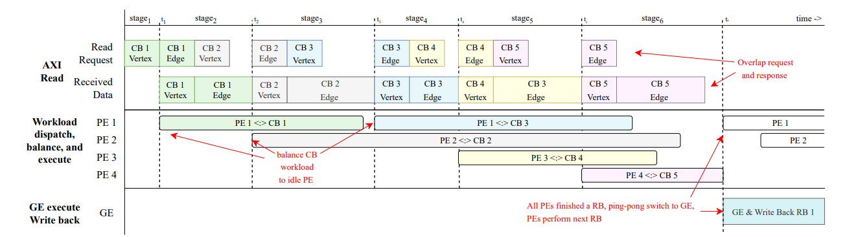
Workflow
Time multiplexing workflow
Notes:
1. First, AXI multiple transaction is enable to overlap data request and response. While receiving Tiles / CBs, it will be dispatched to idle PE, which can achieve auto workload balance. Once a CB finishes transmitting, all PE wait for each other to finish, the partial sum of each PE is addup, and SpMV result is ping-pong switch to GE, PE will be processing next CB will GE is performing TE on previous CB.

Slide 16
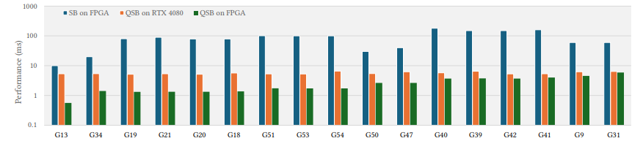
Result
1000 iteration time compared with previous work
As a result, our GPU implementation is 31X faster in best case (G40) and 3.7X faster in worst case (G34) than previous work [1]. Furthermore, our FPGA design Z4 is 4.1X faster in best case (G18) and 1.09X faster in worst case (G31) than our GPU implementation.
[1] Yu Zou and Mingjie Lin. 2020. Massively simulating adiabatic bifurcations with FPGA to solve combinatorial optimization. In Proceedings of the 2020 ACM/SIGDA International Symposium on Field-Programmable Gate Arrays. 65–75.

Slide 17
Future Improvement

Slide 18
Thanks!

